Slide 1
Monolith to Microservices
Craig Russell
Development Team Lead
craig.russell@cloudcall.com

Slide 2
Monolith to Microservices at CloudCall
Why do we have a Monolith?
Drivers for change
Problems we’ve encountered & how we solved them
Technology choices & design patterns
The future…

Slide 3
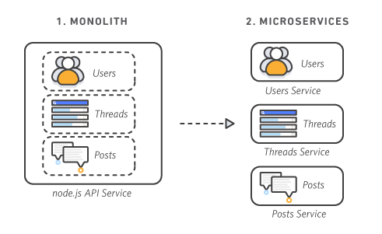
Image: stolen from the internet

Slide 4
Why a monolith?
Single codebase - dependency management is easy
One service to deploy - releases are simple
Access control & security - Global ACL - Single DB
Quick to make changes and adapt to new requests
One thing to think about

Slide 5
“Monolith first”
“Almost all the successful microservice stories have started with a monolith that got too big and was broken up
Almost all the cases where I've heard of a system that was built as a microservice system from scratch, it has ended up in serious trouble”
Martin Fowler
https://martinfowler.com/bliki/MonolithFirst.html

Slide 6
What’s wrong with monoliths?
Capacity
  Different traffic patterns on different endpoints
  Must scale to the lowest common denominator
Repository bloat
  Codebase grows with requirements
  Good coding practices can help, but only up to a point
Scaling Issues
  DB bottlenecks
  MySQL – scale up but not out

Slide 7
How do you start to move on from a monolith?
Straight into microservices??
  Tempting… but no.
Partition traffic patterns through different infrastructure
  Processes for specific endpoints
  DB nodes for specific queries
Useful for identifying how to carve up your monolith

Slide 8
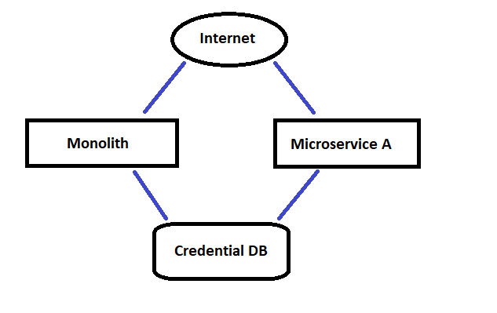
Your first microservice
Image: MS Paint

Slide 9
Your first microservice… is your authentication api
Took the opportunity to revisit our authentication scheme
Legacy API authentication: username, password and API Key
Looked at OpenID, oAuth & Kerberos
Settled on JWT

Slide 10
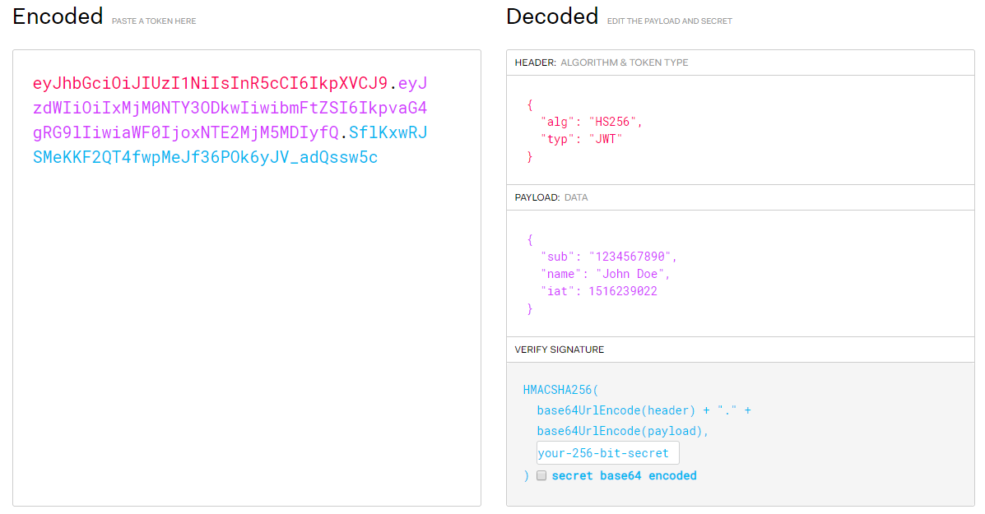

Slide 11
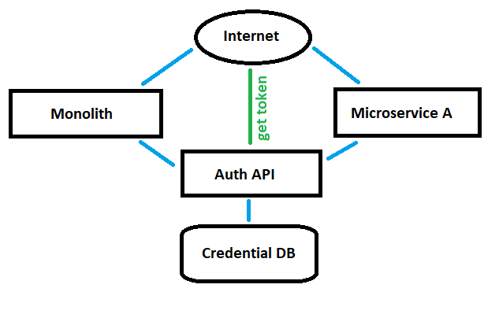
Microservices architecture v1
Image: Also MS Paint

Slide 12
What is an api gateway?
Reverse proxy, turned up to 11
Proxies requests from the internet to back-end services and returns the responses - just like any other reverse proxy
But… with added extra business logic to manipulate the request/response payload and handle the routing

Slide 13
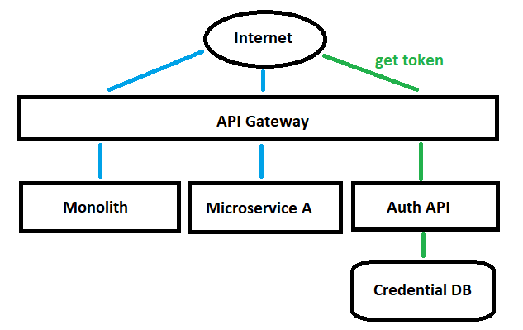
Microservices architecture v2
Image: MS Paint again (last one, I promise)

Slide 14
The Api gateway… what else can it do?
Mixed Authentication Schemes
Authorization
Rate Limiting
Logging
Manipulate requests/responses
Use gateway to guarantee a client response
Decouple public URL paths from services
Use mix of technologies

Slide 15
The Api gateway… what new problems do I have?
Infrastructure
  Significantly more complex
  Pets vs Cattle http://cloudscaling.com/blog/cloud-computing/the-history-of-pets-vs-cattle/
Configuration management
  Config in repo - bad
  Central config management
Logging
  Central logging service
  Log tracing across multiple services - Correlation ID

Slide 16
Microservices at cloudcall the future
Continuous Integration
Integration Testing
Central Package Repository
Coding Standards
Resiliency - Chaos Monkey
Documentation – Swagger
Adopting unknown new technologies

Slide 17

(I lied)

